Slide 1
BANKING STOCKS
Analysis using Descriptive Statistics

Slide 2
LETS START!

Slide 3
Table of Contents
01
02
03
04
INTRODUCTION
DATASET
What is Descriptive Statistics?
What is the dataset about?
OBJECTIVE
RESULT
Explanatory analysis of the Dataset
Interpretation based on objective
Comparison of 3 stocks

Slide 4
“Descriptive statistics summarizes a given data set, which can be either a representation of the entire population or a sample of a population. It is broken down into measures of central tendency and measures of variability (spread). Measures of central tendency include the mean, median, and mode, while measures of variability include standard deviation, variance, minimum and maximum variables, kurtosis, and skewness.”
—Definition

Slide 5
01
INTRODUCTION
Concepts & Theory

Slide 6
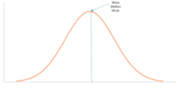
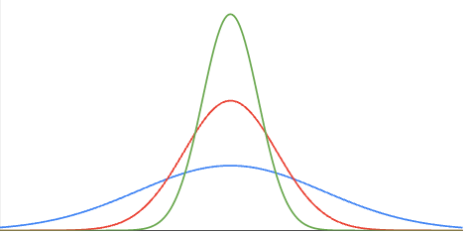
Two components of Descriptive Statistics
Measures of Central Tendency
Measures of Variability
Mean
Median
Mode
Standard Deviation
Variance, COV
Max, Min, Quartiles
Skewness
Kurtosis

Slide 7
MEASURES OF CENTRAL TENDENCY
It mainly includes mean, median, mode:
Mean- Calculated average (Arithmetic average)
Median- Positional average (Middle Value)
Mode- Value with highest frequency

Slide 8
MEASURES OF VARIABILITY
Standard Deviation – Deviation from mean
Variance – Spreadness of data
Coefficient of Variance – Standard deviation / Mean
Maximum – Highest value of the dataset
Minimum – Lowest value of the dataset
Quartiles - Describes a division of observations into four defined intervals
Skewness – Measure of symmetry of distribution (Horizontal)
Kurtosis – Sharpness of peak of distribution curve (Vertical)

Slide 9
02
DATASET
Overview & Details

Slide 10



The three bank stocks we analysed :
HDFC
AXIS
ICICI
We Understand Your World
Badhti Ka Naam Zindagi
Khayal Apka

Slide 11

DATASET
We selected the stocks of HDFC Bank Limited (HDFCBANK.NS), Axis Bank Limited (AXISBANK.NS) and ICICI Bank Limited (ICICIBANK.NS) from Yahoo Finance. The time duration was from 16/10/2018 to 16/10/2021 (3 years). We calculated the value of Return, Summary Statistics, Pivot table and Histogram for this stock.

Slide 12
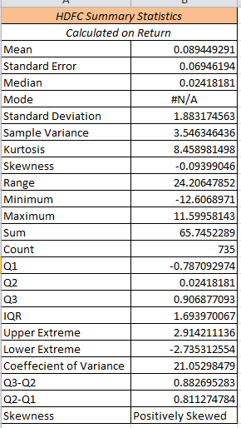
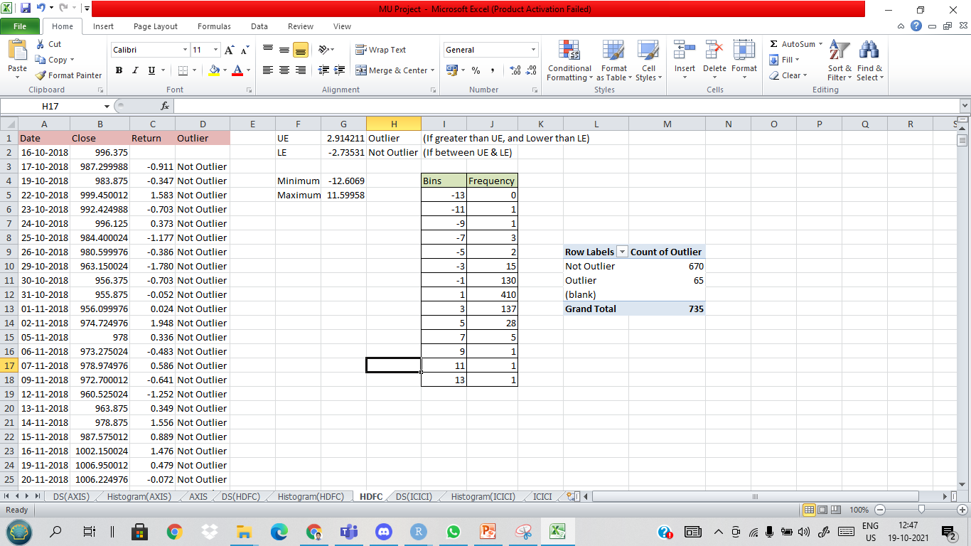
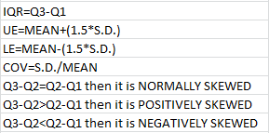
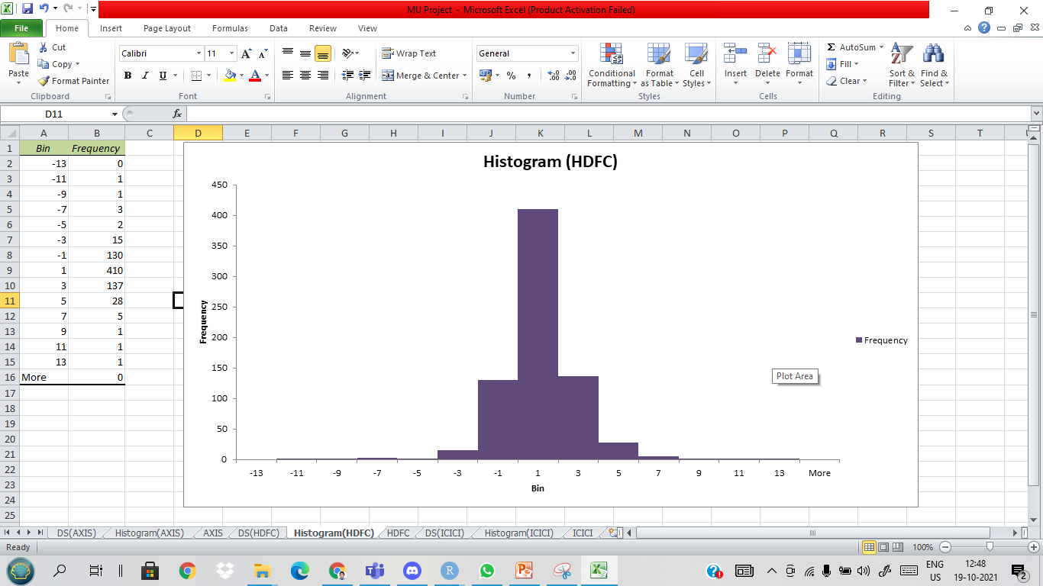
HDFC (Excel)

Slide 13
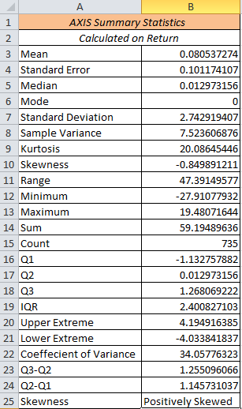
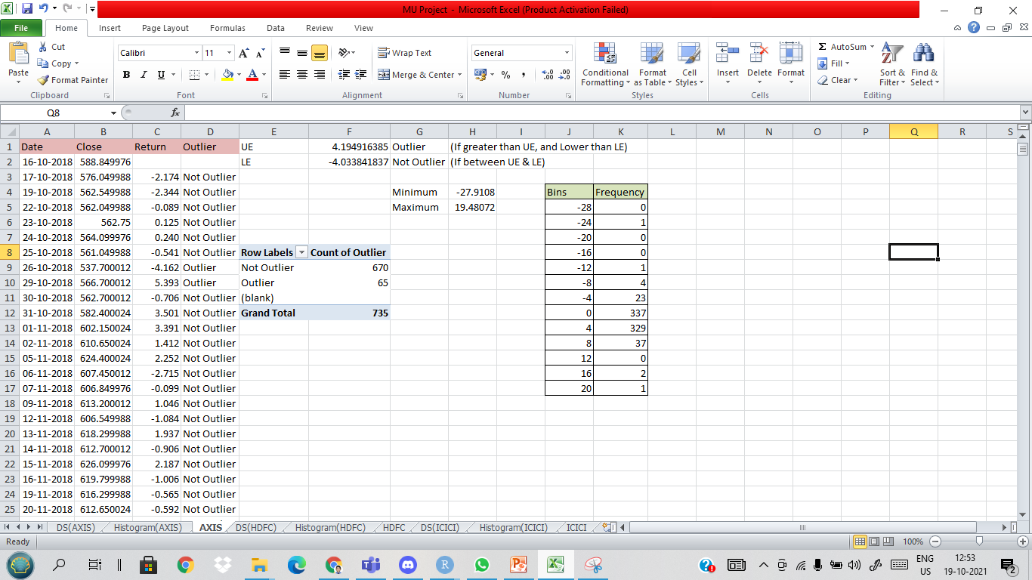
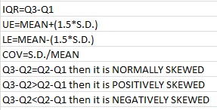
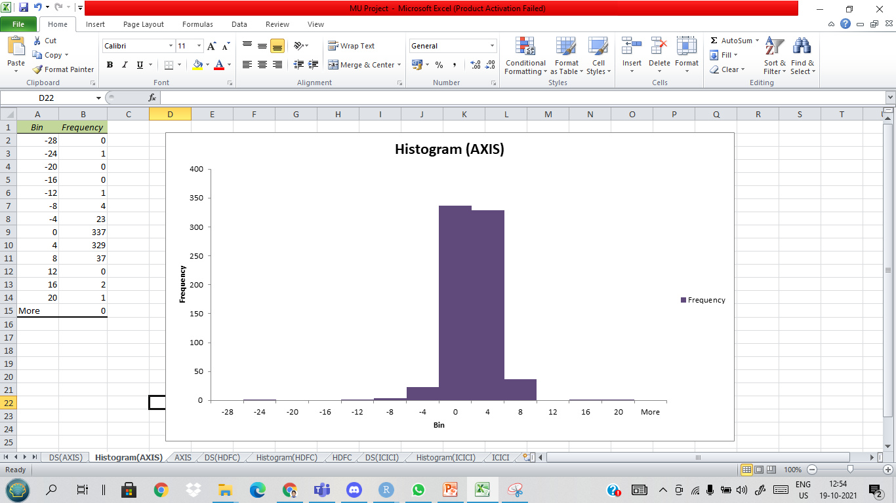
AXIS (Excel)

Slide 14
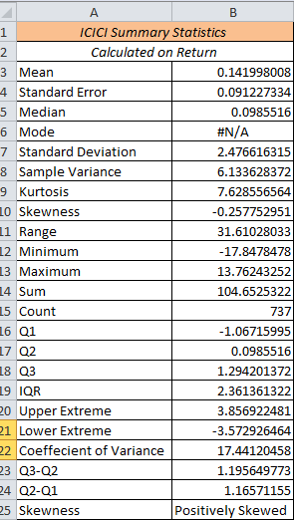
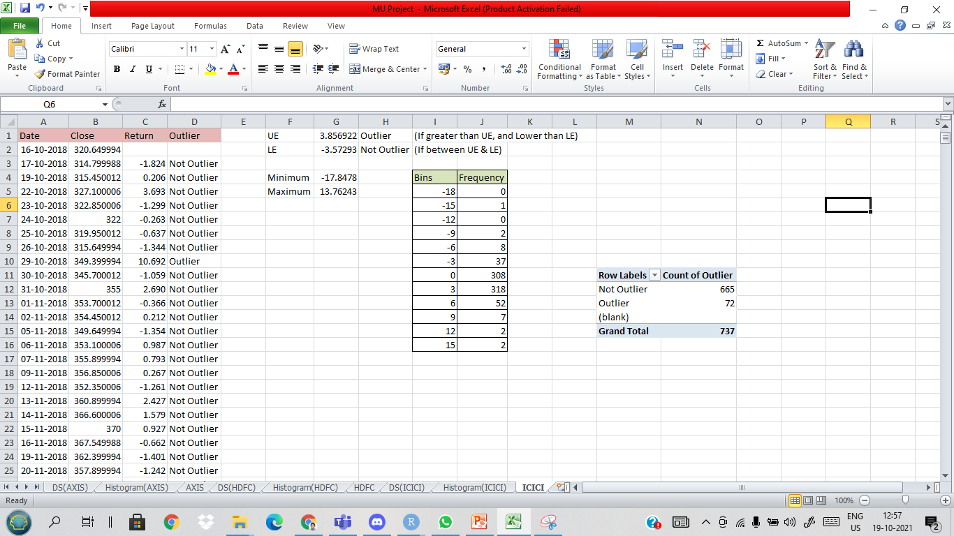
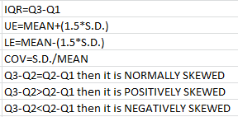
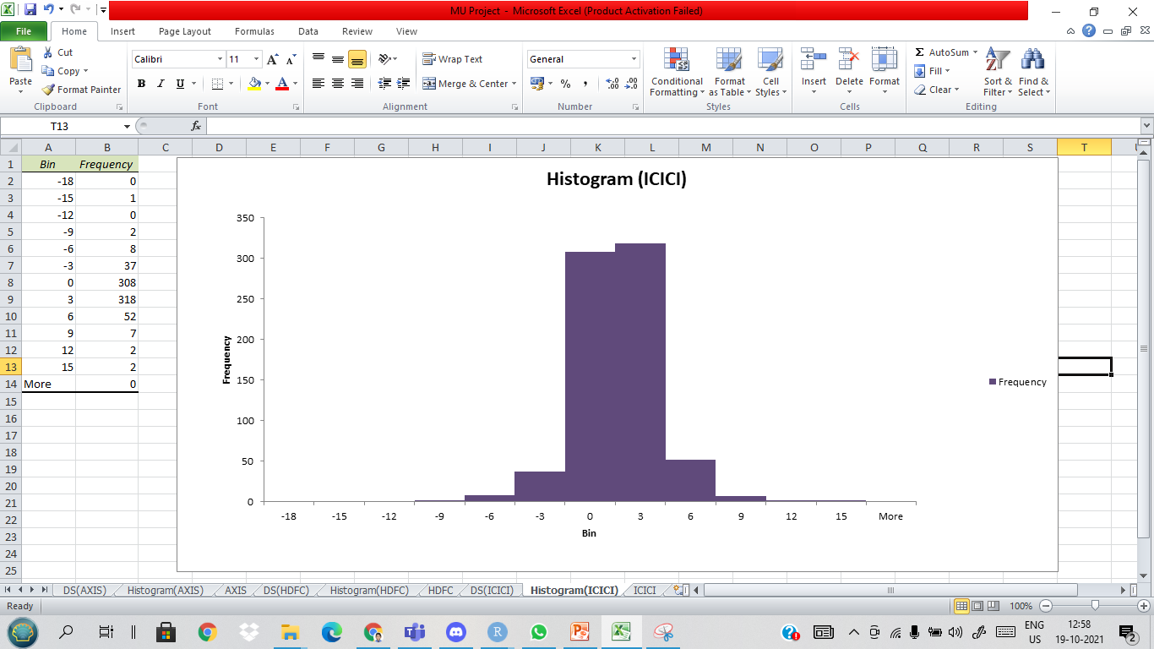
ICICI (Excel)

Slide 15

03
OBJECTIVE
Visualisations & Analysis

Slide 16

An image is worth a thousand words so:
VISUALISATIONS

Slide 17
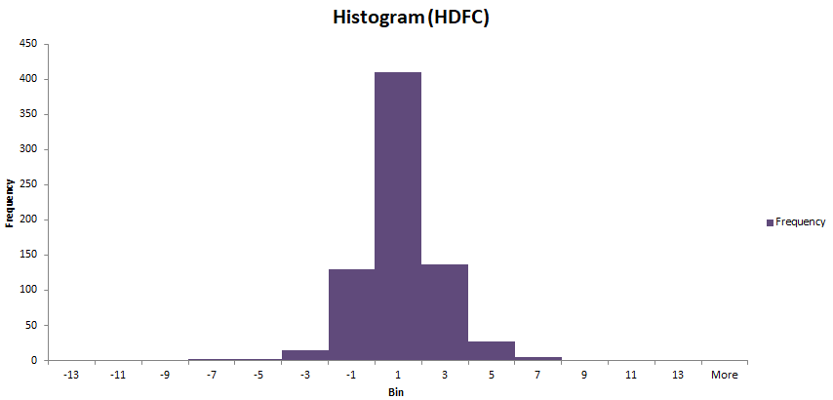
HISTOGRAMS

Slide 18
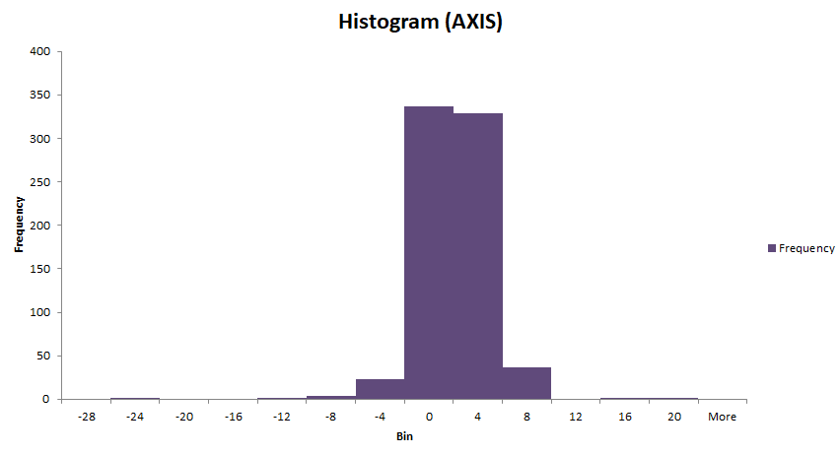
HISTOGRAMS

Slide 19
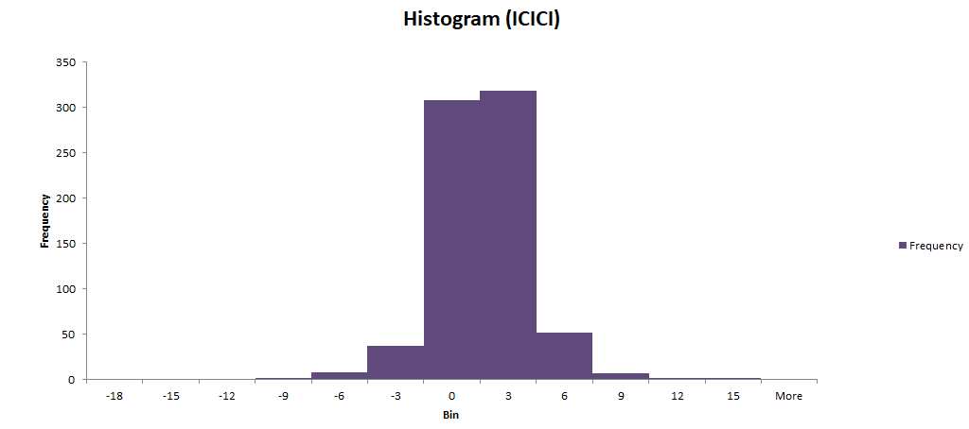
HISTOGRAMS

Slide 20
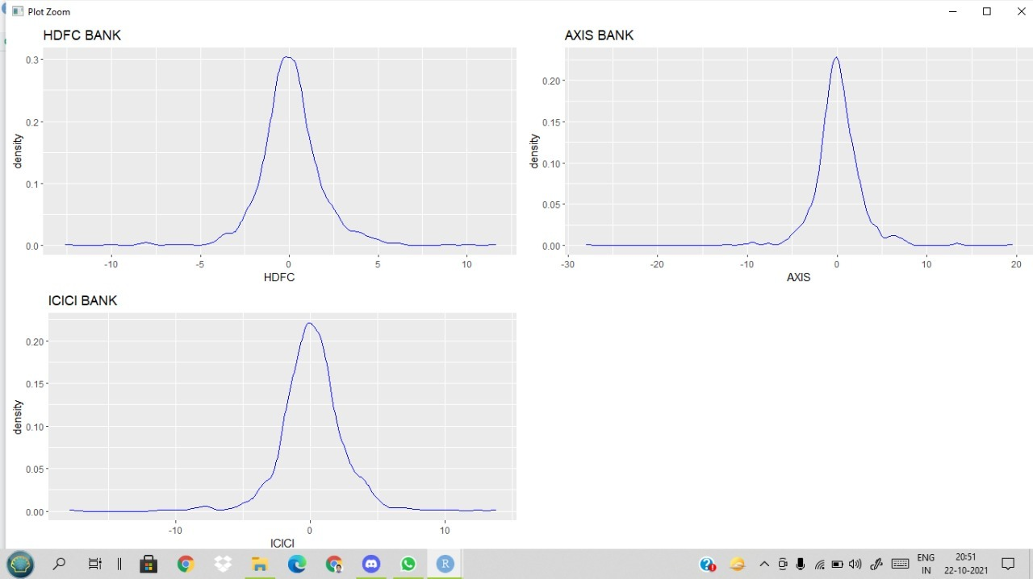
DENSITY PLOT USING R

Slide 21
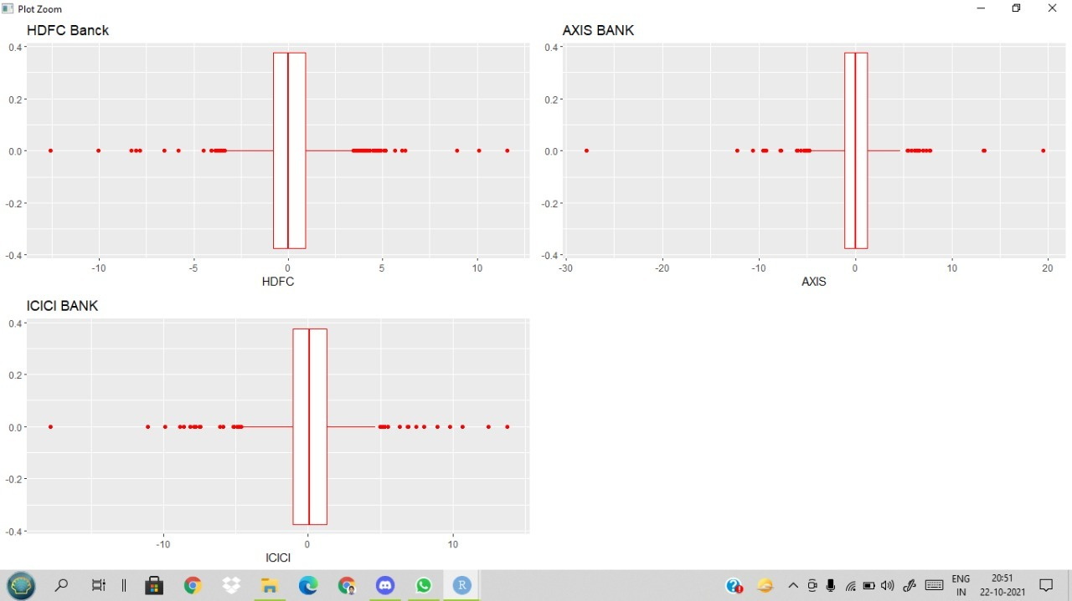
BOX PLOT USING R

Slide 22
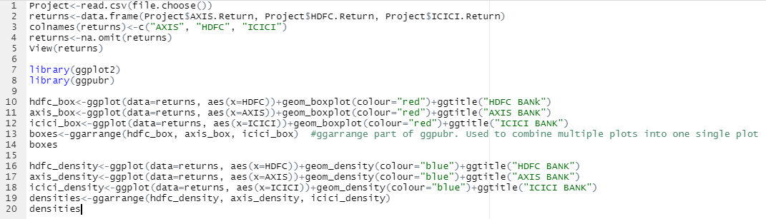
R CODE

Slide 23
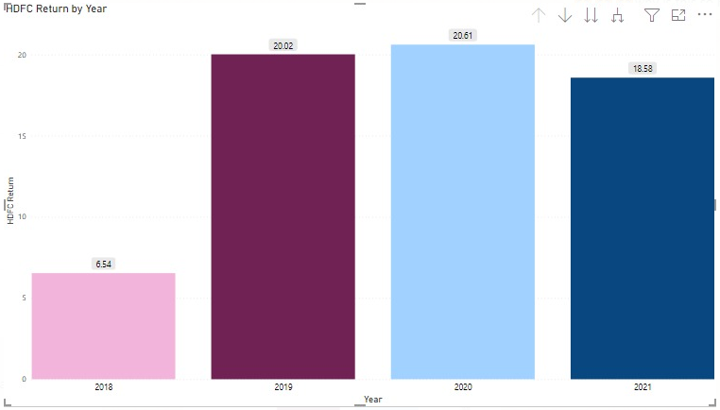
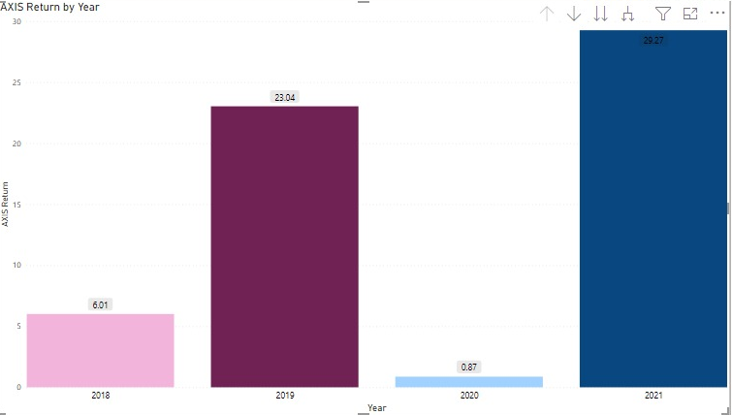
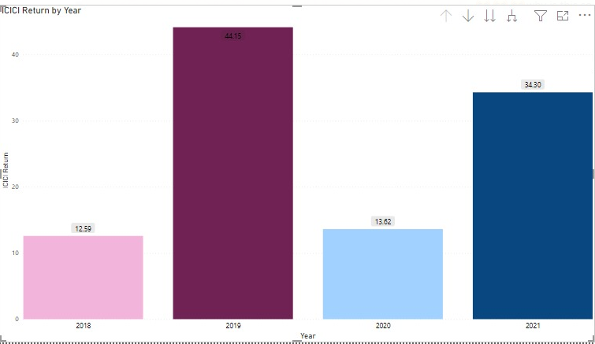
BAR CHARTS USING POWER BI
HDFC
AXIS
ICICI

Slide 24
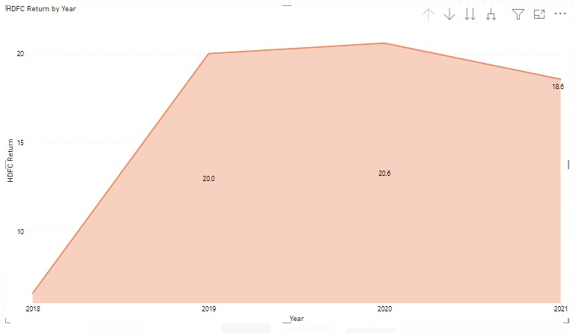
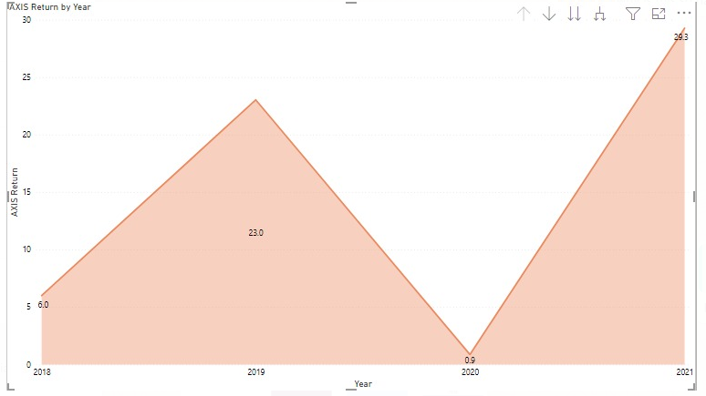
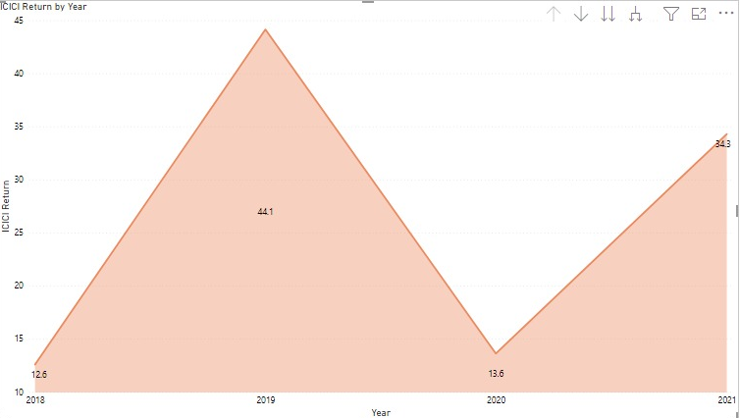
AREA CHART USING POWER BI
HDFC
AXIS
ICICI

Slide 25
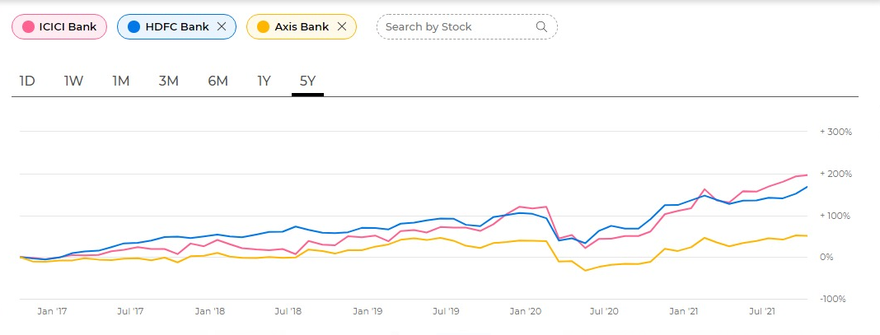
TIME SERIES PLOTS (COMPARISION)

Slide 26
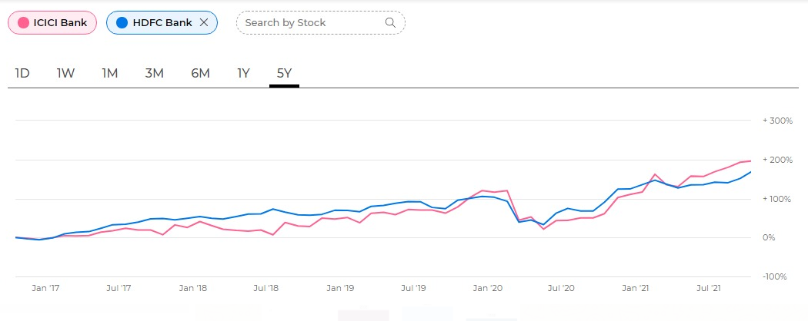
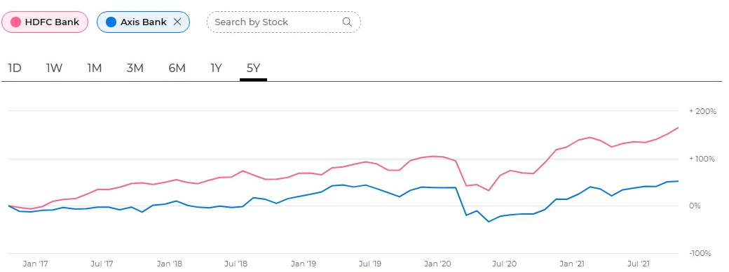
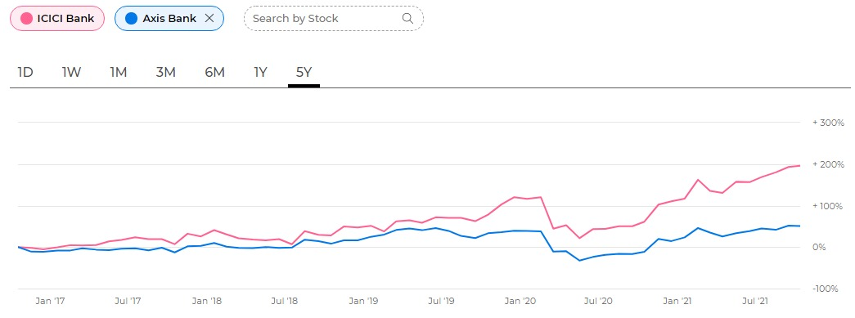
TIME SERIES PLOTS (COMPARISION)

Slide 27
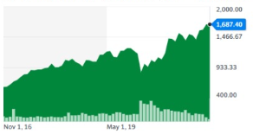
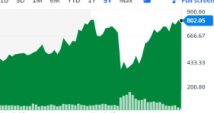
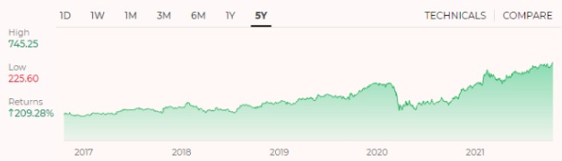
TIME SERIES PLOTS (COMPARISION)
HDFC
AXIS
ICICI

Slide 28
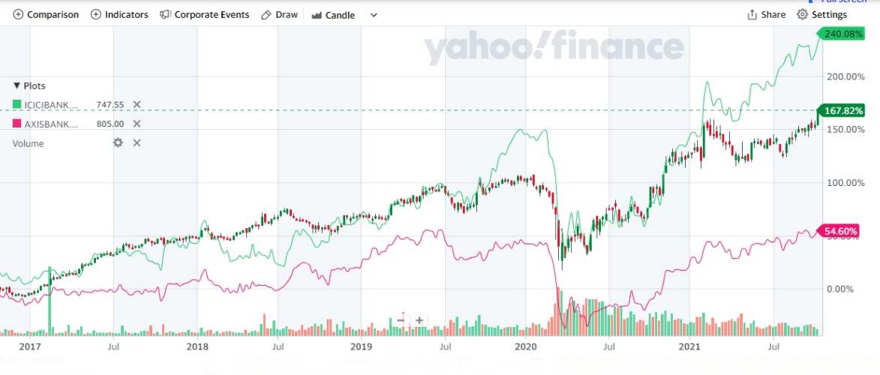
HDFC v/s AXIS v/s ICICI

Slide 29
Awesome words
ANALYSIS

Slide 30
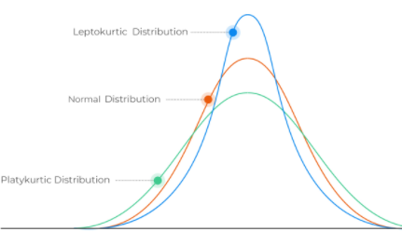
ANALYSIS
Here’s what we found out from the descriptive stats and visualisations:
The high risk and variability of AXIS is also proved by the large value of Standard Deviation associated with it. High Standard Deviation shows that the data is more spread out ffrom the average line. The great risk is also backed by the hugh value for standard error this stock has.
Mean values were: AXIS – 0.0805, HDFC – 0.0894, ICICI – 0.142. ICICI has highest mean which means on an average the Returns of ICICI were greater than compared to the other two. Though some values of Return maybe greater or lower than this mean value.
The Kurtosis value for AXIS is the highest by almost 3 times of the rest. This means that it has the highest peak value of Return & that there has been a very high profit recorded. The graph for the comparision of the 3 kurtosis would look something like this:
For AXIS IQR is very high (the middle 50% of dataset has a very high value). The Range (max-min) also has a high value which means maxium is greater and minimum is lower (high profits & high losses)
AXIS
HDFC
ICICI

Slide 31
MEAN STDEV SKEWNESS
 | AXIS | HDFC | ICICI
MEAN | 0.0805 | 0.0894 | 0.1419
STDEV | 2.7429 | 1.8831 | 2.4766

Slide 32
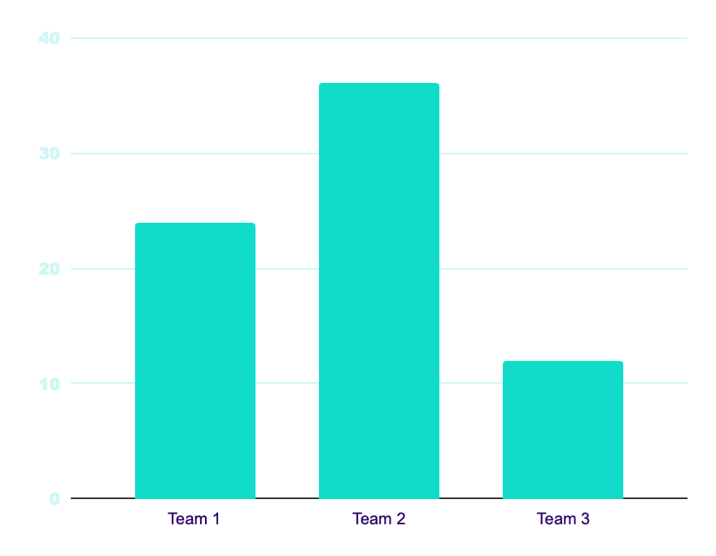
KURTOSIS
AXIS
AXIS
Kurtosis value – 20.086
HDFC
HDFC
Kurtosis value – 8.459
ICICI
ICICI
Kurtosis value – 7.628

Slide 33
ANALYSIS
AXIS also has the highest value for COV & Variance. This shows that the volatility in Returns is high and they are very fluctuating. The stability in turn is low making this stock less appropriate for long term investment and increasing the risk. Although it is good for short term investment as high variability means there are chances for very high profits (than usual) but the losses can also be more than expected.
For all the three banks the mean & skewness both is positive (larger tail is towrads the more positive values i.e. more profits than losses) showing that the outliers are not so much (the outlier percentage is low) that they will affect the skewness of the graph and pull it any one side.
The standard error for AXIS is 0.1011, HDFC – 0.069, ICICI – 0.091. Another reason for HDFC being more stable is it has less error .
For HDFC the difference between [Q3-Q2] & [Q2-Q1] is very less suggesting that the graph is not pulled to any one side completely & that there is not extreme profit or loss. This signifies a normally skewed distribution. This shows that it is stable & good for long term investment.
The histograms of all the three stocks show a bell shaped curve which helps us identify the distribution as a normal one and suggests that no modification has been made to this dataset and is a natural series. Thus the source can be trusted.
The outlier percentage for AXIS was 8.84%, HDFC – 8.84%, ICICI – 9.77%. ICICI Bank had the highest outlier percentage. This means that there were more values of Returns in ICICI that were outside the accepted range. Most Profits were either higher than expected or losses were lower than expected. This portrays high risk and inconsistency in the stocks.

Slide 34
COV & VARIANCE
AXIS
HDFC
ICICI
COV – 34 (Highest)
COV – 21
COV – 17 (Lowest)
AXIS
HDFC
ICICI
Variance – 7.523 (Highest)
Variance – 3.540
(Lowest)
Variance – 6.133

Slide 35
SKEWNESS
 | AXIS | HDFC | ICICI
SKEWNESS | -0.8498 | -0.0939 | -0.2577

Slide 36
HDFC
Standard Error
AXIS
0.1011
[Q3-Q2]
[Q2-Q1]
HDFC
0.069
0.88
0.81
ICICI
0.091
Difference in both is very less

Slide 37
OUTLIER PERCENTAGE
AXIS
HDFC
8.84%
8.84%
9.77%
ICICI

Slide 38
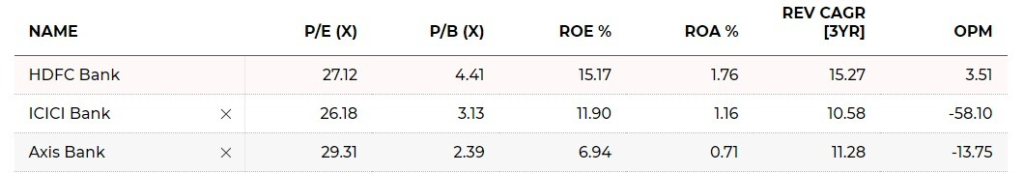
Comparison based on Ratio Performance
Company a | company b | company c | company d
+1.23 | +3.32 | +2.11 | -1.21
H
H
H
H
H
H

Slide 39
EXPLANATION
P/E (X) – Relates a company’s share price to it’s earnings per share
P/B (X) – Checks whether company’s stock price is valued properly
ROE% - Measures the rate of return that the owners of the common stock of a company receive on their share holdings.
ROA% - Indicator of how profitable a company is relative to it’s total assets
REV CAGR [3YR] – Rate of Return
OPM – Operating Profit Margin

Slide 40

04
RESULT
Comparision & Conclusion

Slide 41

HDFC
The most stable bank award goes to:

Slide 42



Reasons why HDFC is most stable:
STDEV
COV
STD. ERROR
Least deviation from mean
Least COV not inconsistent
Least Std. Error not risky

Slide 43

AXIS
Good for short term investment Very high profit
But high risk
Possibility of high loss also there

Slide 44
ICICI
The mean is showing as highest as it is affected by the large number of outliers shown by the highest outlier percentage that it has.

Slide 45
OUR TEAM
Aarohi Mhaske
Sreeja Paul
J014
J020

Slide 46
Thanks!

